Slide 1
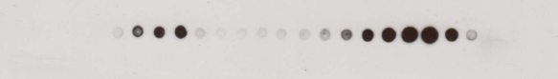
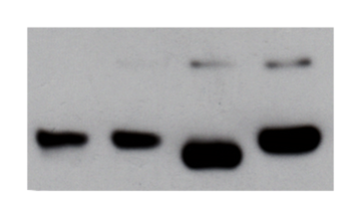
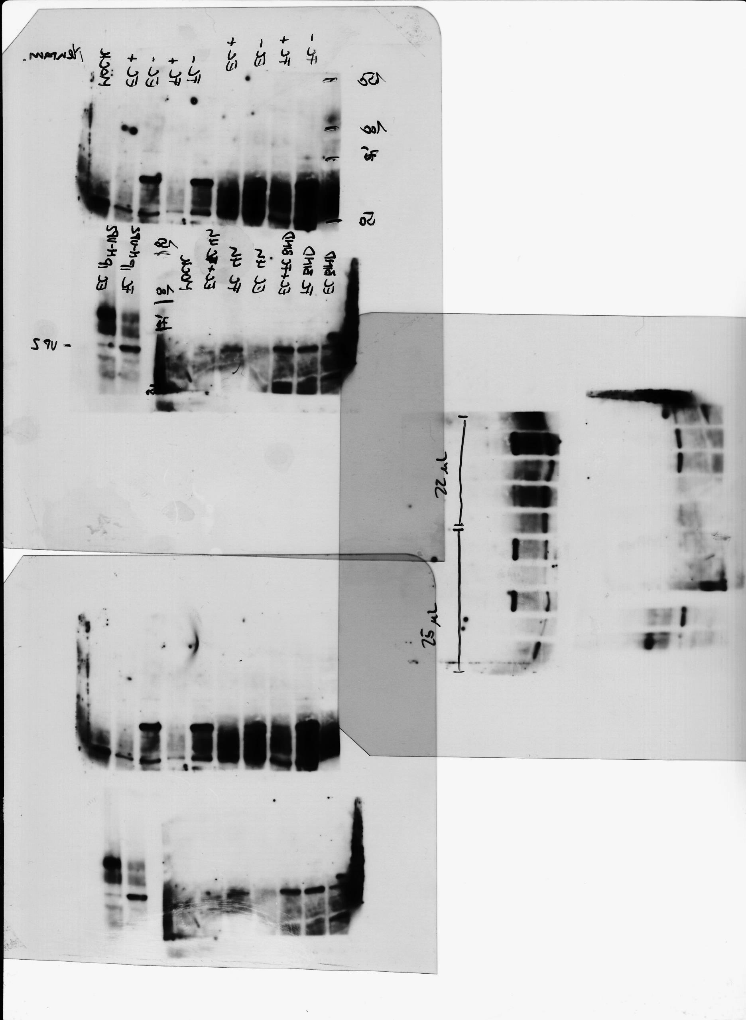
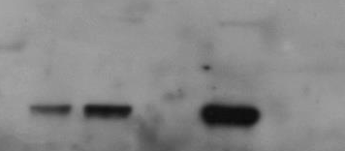
Purification of FC and EC
1 2 3 4 5 6 7 8 9 10 11 12 13 14 15 16 17 18 19 20 21 22 23 24
Empty Capsids
Full Capsids
FC IP^{B7}
EC IP^{B7}
FC IP^{N-VP2}
EC IP^{N-VP2}
FC EC FC EC
- - + + Cht
VP1
VP1
VP2
VP2
VP3
EC and FC bind sialic acids
EC
5
FC
5
FC
5
EC
25
EC
25
MOI
Neur
-
-
+
-
+
VP1
VP2

Slide 2
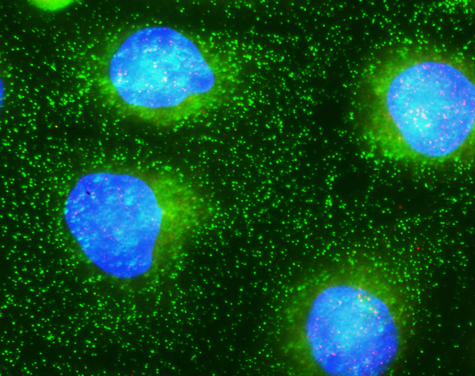
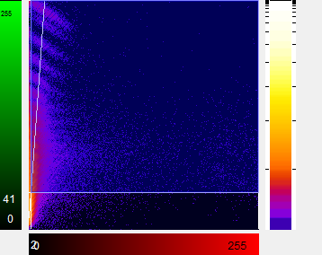
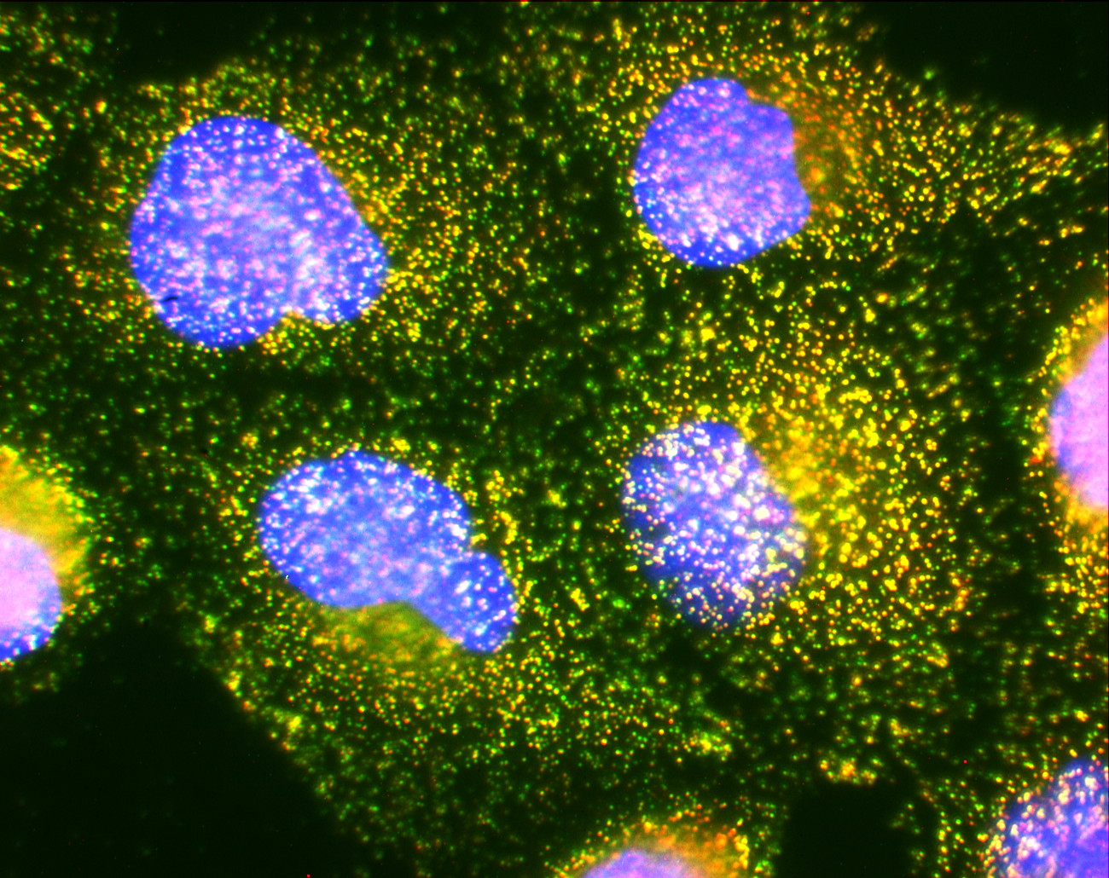
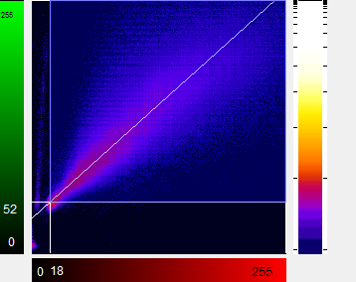
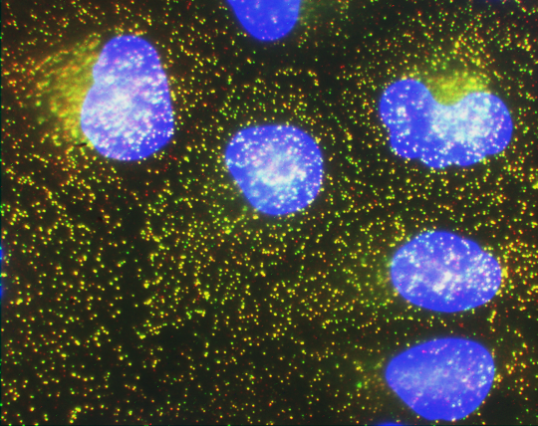
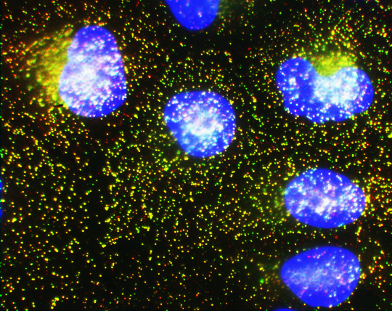
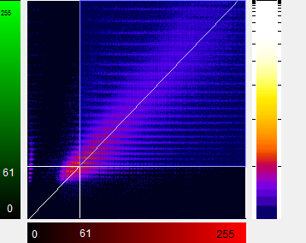
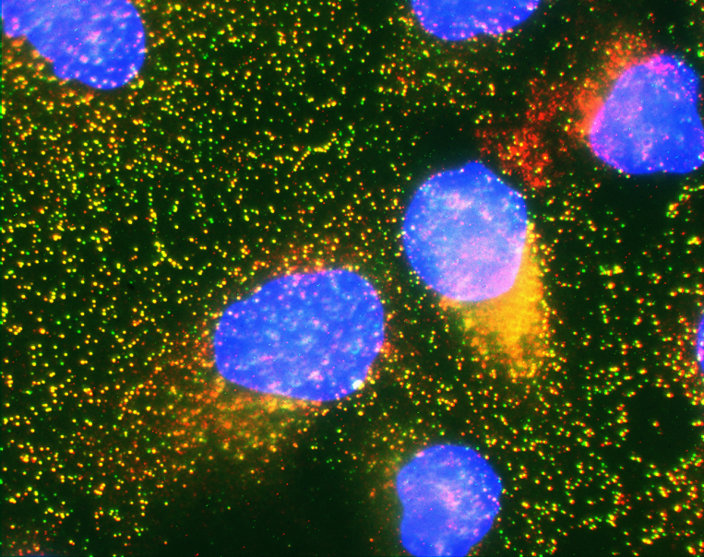
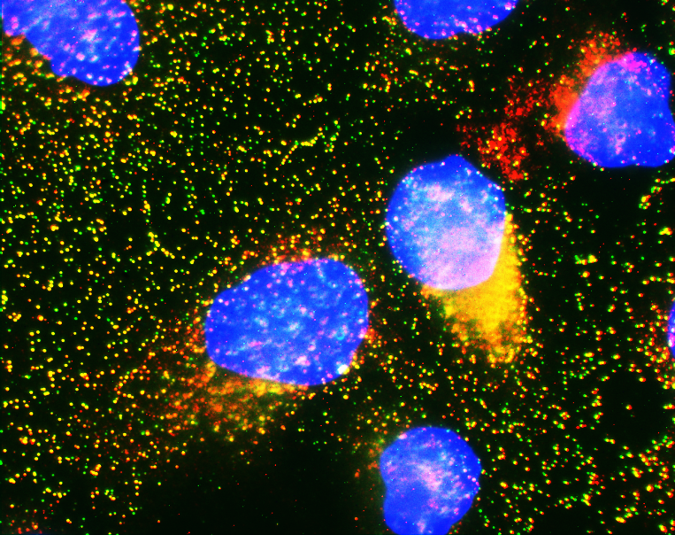
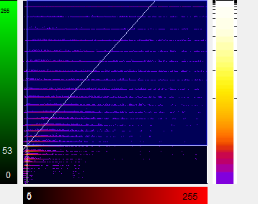
FC has priority over EC (higher affinity for SA)
Binding
Amplification
Scatter Plot
EC
FC
EC + FC
EC(30’) + FC

